Slide 1



01AI0506 - Design and Analysis of Algorithm
Unit – 5
Backtracking and Branch and Bound
Prepared by
Prof. Abhishek Chauhan
CSE- AI, ML & DS Department

Slide 2




OUTLINE
Introduction
The Eight queens problem
Knapsack problem
Travelling Salesman problem
Minimax principle

Slide 3
Introduction to backtracking
Backtracking can be defined as a general algorithmic technique that considers searching every possible combination in order to solve an optimization problem.
It is a recursive technique. It generates a state space tree for all possible solutions. A space state tree is a tree representing all the possible states (solution or nonsolution) of the problem from the root as an initial state to the leaf as a terminal state.
It traverse the state space tree in the depth first order. So, in a backtracking we attempt solving a sub-problem, and if we don't reach the desired solution, then undo whatever we did for solving that sub-problem, and try solving another sub-problem.

Slide 4
Introduction to backtracking
All the solutions require a set of constraints divided into two categories: explicit and implicit constraints.
Explicit constraints are rules that restrict each x_{i} to take on values only from a given set.
Explicit constraints depend on the particular instance I of problem being solved
All tuples that satisfy the explicit constraints define a possible solution space for I
Implicit constraints are rules that determine which of the tuples in the solution space of I satisfy the criterion function.
Implicit constraints describe the way in which the x_{i}s must relate to each other.

Slide 5
Introduction to backtracking
Terminologies which is used backtracking:
1.Solution Space: All tuples that satisfy the explicit constraints define a possible solution space for a particular instance T of the problem.
2.Problem State: A problem state is the state that is defined by all the nodes within the tree organization.
3.Solution States: These are the problem states S for which the path form the root to S defines a tuple in the solution space. Here, square nodes ( ) indicate solution. For the above solution space, there exists 3 solution states. These solution states represented in the form of tuples i.e., (ghk-,B,D),(A,C,F) and (A,C,G) are the solution states.

Slide 6
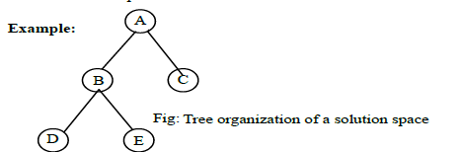

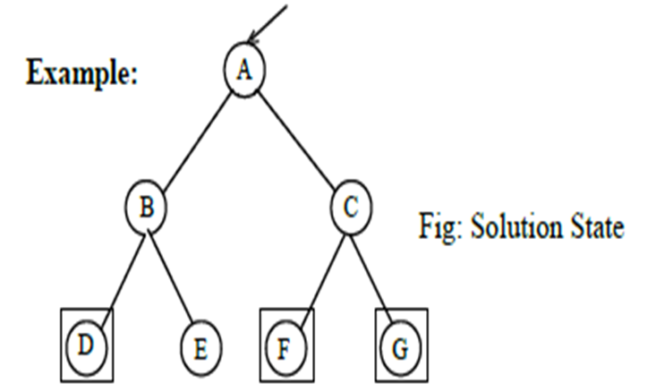
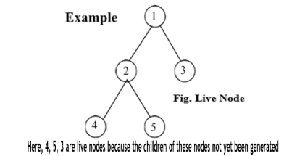
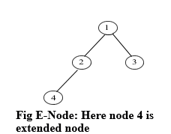
Introduction to backtracking

Slide 7
Introduction to backtracking
4.State Space Tree: Is the set of paths from root node to other nodes. State space tree is the tree organization of the solution of the solution space.
Example: State space tree of a 4-queen problem.
5.Live Node: A node which has been generated but whose children have not yet been generated is live node.
6.E-Node: The live nodes whose children are currently being generated is called the E-node (node being expanded).
7.Dead Node: It is generated node, that is either not to be expanded further or one for which all of its children has been generated.

Slide 8
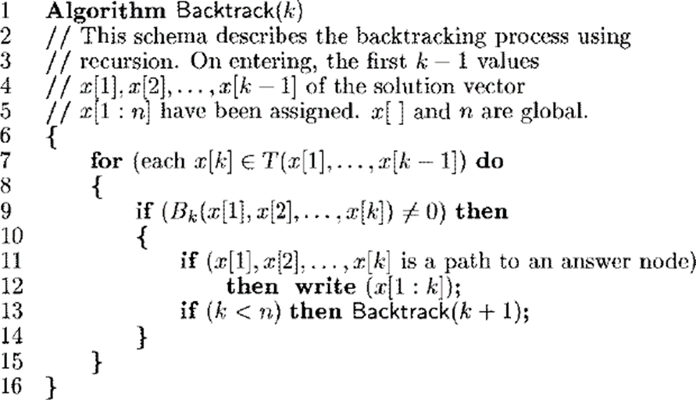
Introduction to backtracking

Slide 9
N - Queen Problem
The 𝑁 - queen is the problem of placing N chess queens on an 𝑁×𝑁 chessboard so that, no two queens attack each other.Here, we solve the problem for N = 4 Queens.
Before solving the problem, let's know about the movement of the queen in chess.
In the chess game, a queen can move any number of steps in any direction like vertical, horizontal, and diagonal.
The constraint is that two queens of same row, same column or the same diagonal can attack each other.
In the 4 - Queens problem we have to place 4 queens such as Q1, Q2, Q3, and Q4 on the chessboard, in such a way that no two queens attack each other.
To solve this problem generally Backtracking algorithm or approach is used.

Slide 10
N - Queen Problem
Backtracking for N - Queen Problem
In backtracking, start with one possible move out of many available moves, then try to solve the problem.
If it can solve the problem with the selected move then it will print the solution, else it will backtrack and select some other move and try to solve it.
If none of the moves works out the claim that there is no solution for the problem.

Slide 11
N - Queen Problem
Algorithm for N-Queens Problem using Backtracking
Step 1 - Place the queen row-wise, starting from the left-most cell.
Step 2 - If all queens are placed then return true and print the solution matrix.
Step 3 - Else try all columns in the current row.
Condition 1 - Check if the queen can be placed safely in this column then mark the current cell [Row, Column] in the solution matrix as 1 and try to check the rest of the problem recursively by placing the queen here leads to a solution or not.

Slide 12
N - Queen Problem
Condition 2 - If placing the queen [Row, Column] can lead to the solution return true and print the solution for each queen's position.
Condition 3 - If placing the queen cannot lead to the solution then unmark this [row, column] in the solution matrix as 0, BACKTRACK, and go back to condition 1 to try other rows.
Step 4 - If all the rows have been tried and nothing worked, return false to trigger backtracking

Slide 13
N - Queen Problem
Working of an Algorithm to solve the 4-Queens Problem
To solve the problem place a queen in a position and try to find out all the possibilities for any queen being under attack or not.
Based on the findings place only one queen in each row/column.
If we found that the queen is under attack at its chosen position, then try for the next position.
If a queen is under attack at all the positions in a row, we backtrack and change the position of the queen placed prior to the current position.
Repeat this process of placing a queen and backtracking until all the N queens are placed successfully.

Slide 14
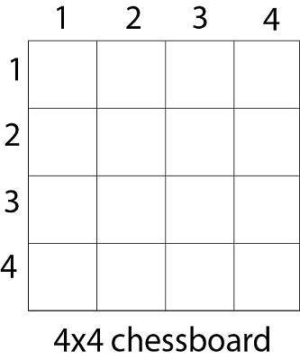
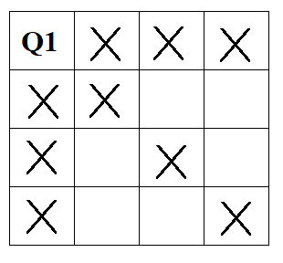
N - Queen Problem
Step 1 :
As this is the 4-Queens problem, therefore, create a 4×4 chessboard.
Step 2 :
Place the Queen Q1 at the left-most position which means row 1 and column 1.
Mark the cells of the chessboard with cross marks that are under attack from a queen Q1. (horizontal, vertical, and diagonal move of the queen)
The chessboard looks as follows after placing
Q1 at [1, 1] position.

Slide 15
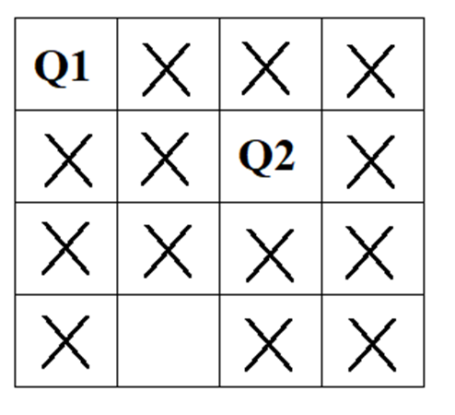
N - Queen Problem
Step 3:
The possible safe cells for Queen Q2 at row 2 are of column3 and 4 because these cells do not come under the attack from a queen Q1.
So, here we place Q2 at the first possible safe cell which is row 2 and column 3.
Mark the cells of the chessboard with cross marks that are under attack from a queen Q2. (horizontal, vertical, and diagonal move of the queen)
The chessboard looks as follows after placing Q2 at [2, 3] position.

Slide 16
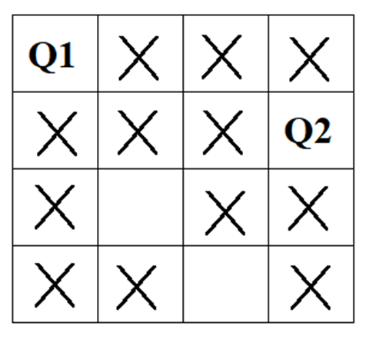
N - Queen Problem
Step 4 :
We see that no safe place is remaining for the Queen Q3 if we place Q2 at position [2, 3]
Therefore make position [2, 3] false and backtrack.
Step 5 :
So, we place Q2 at the second possible safe cell which is row 2 and column 4.
Mark the cells of the chessboard with cross marks that are under attack from a queen Q2. (horizontal, vertical, and diagonal move of the queen)
The chessboard looks as follows after placing Q2 at [2, 4] position.

Slide 17
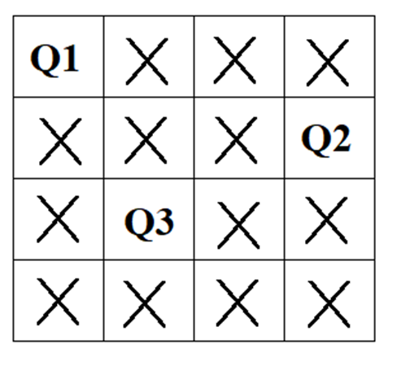
N - Queen Problem
Step 6 :
The only possible safe cell for Queen Q3 is remaining in row 3 and column 2.
Therefore, we place Q3 at the only possible safe cell which is row 3 and column 2.
Mark the cells of the chessboard with cross marks that are under attack from a queen Q3. (horizontal, vertical, and diagonal move of the queen)
The chessboard looks as follows after placing Q3 at
[3, 2] position.

Slide 18
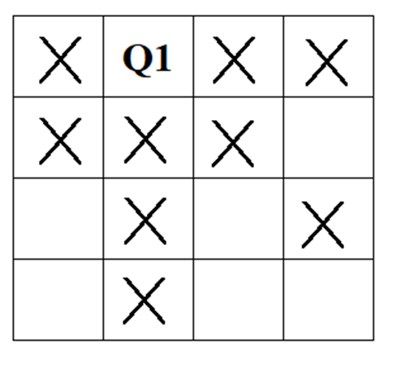
N - Queen Problem
Step 7:
We see that no safe place is remaining for the Queen Q4 if we place Q3 at position [3, 2]
Therefore make position [3, 2] false and backtrack.
Step 8:
This time we backtrack to the first queen Q1.
Place the Queen Q1 at column 2 of row 1.
Mark the cells of the chessboard with cross marks that are under attack from a queen Q1. (horizontal, vertical, and diagonal move of the queen)
The chessboard looks as follows after placing Q1 at [1, 2] position.

Slide 19
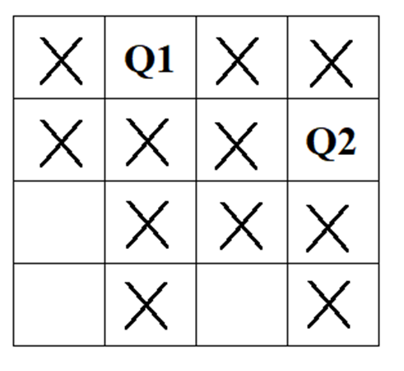
N - Queen Problem
Step 9:
The only possible safe cell for Queen Q2 is remaining in row 2 and column 4.
Therefore, we place Q2 at the only possible safe cell which is row 2 and column 4.
Mark the cells of the chessboard with cross marks that are under attack from a queen Q2. (horizontal, vertical, and diagonal move of the queen)
The chessboard looks as follows after placing Q2 at [2, 4] position.

Slide 20
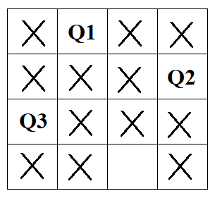
N - Queen Problem
Step 10:
The only possible safe cell for Queen Q3 is remaining in row 3 and column 1.
Therefore, we place Q3 at the only possible safe cell which is row 3 and column 1.
Mark the cells of the chessboard with cross marks that are under attack from a queen Q3. (horizontal, vertical, and diagonal move of the queen)
The chessboard looks as follows after placing Q3 at [3, 1] position

Slide 21
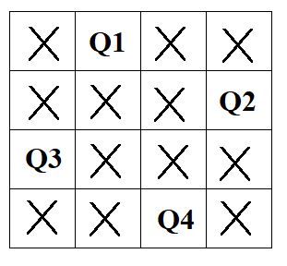
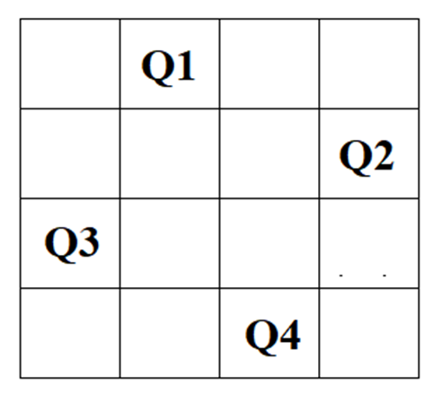
N - Queen Problem
Step 11:
The only possible safe cell for Queen Q4 is remaining in row 4 and column 3.
Therefore, we place Q4 at the only possible safe cell which is row 4 and column 3.
The chessboard looks as follows after placing Q4 at [4, 3] position.
Now, here we got the solution for the 4-queens problem because all 4 queens are placed exactly in each row/column individually.

Slide 22
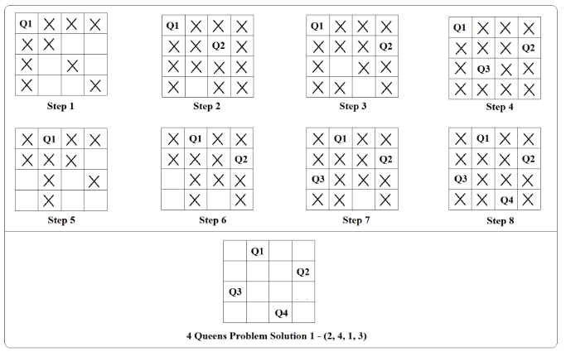
N - Queen Problem
Solution 1: All these procedures are shown sequentially in the below figure
This is not the only possible solution to the problem.
If we move each queen one step forward in a clockwise manner, we get another solution.

Slide 23
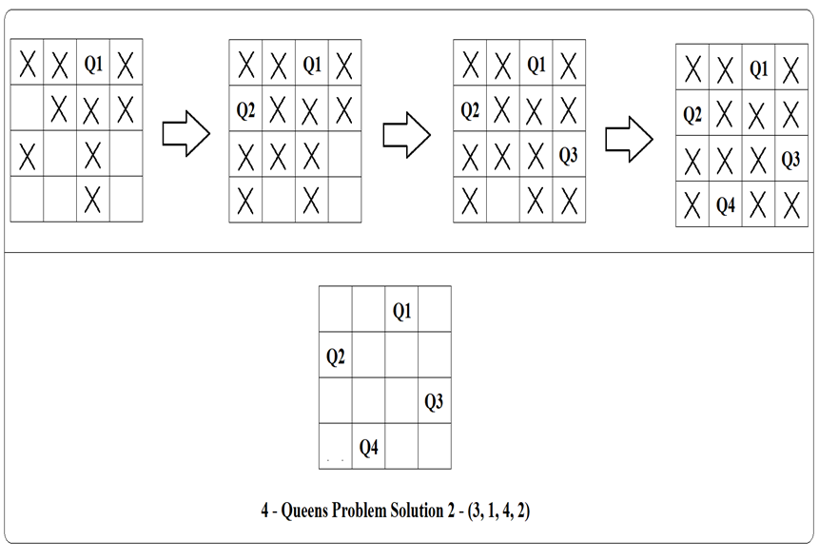
N - Queen Problem
Solution 2
In this example we placed the queens according to rows, we can do the same thing column-wise also.
In that case, each queen will belong to a column.

Slide 24
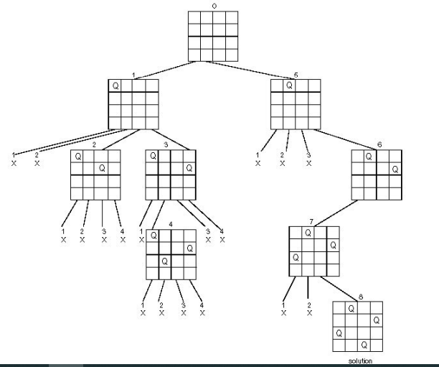
N - Queen Problem -State space tree

Slide 25
N - Queen Problem
8-queens Problem:
We can solve this problem in the same way as in 4-queens.
Place eight queen on 8 x 8 chessboard so that no queen attacks another queen.
A queen attacks another queen if the two are in the same row, column or diagonal.
We can solve this problem in the same way as in 4 queens.
For 8-queens, generally 92 solutions are possible, excluding symmetry, only 12 unique solutions exist.

Slide 26
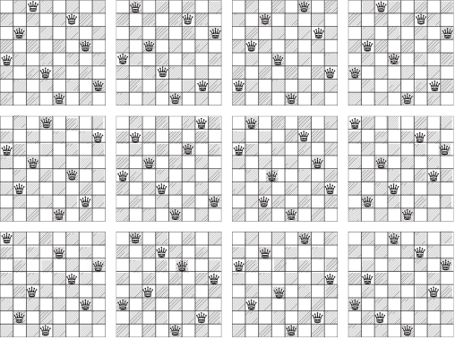
N - Queen Problem

Slide 27
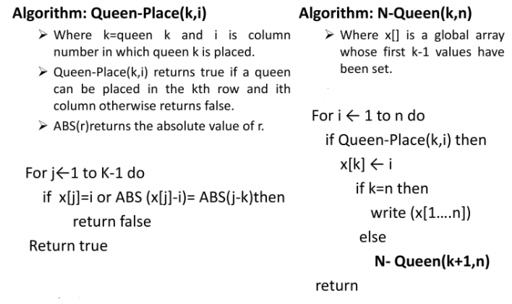
N - Queen Problem

Slide 28
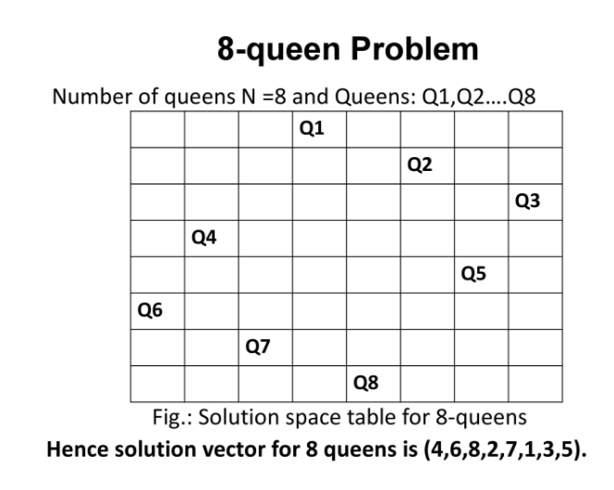
N - Queen Problem

Slide 29
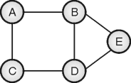
Hamiltonian Cycle using Backtracking
The Hamiltonian cycle is the cycle in the graph which visits all the vertices in graph exactly once and terminates at the starting node. It may not include all the edges.
The Hamiltonian cycle problem is the problem of finding a Hamiltonian cycle in a graph if there exists any such cycle.
The input to the problem is an undirected, connected graph. For the graph shown in graph, a path A – B – E – D – C – A forms a Hamiltonian cycle. It visits all the vertices exactly once, but does not visit the edges <B, D>.

Slide 30
Hamiltonian Cycle using Backtracking
The Hamiltonian cycle problem is also both, decision problem and an optimization problem. A decision problem is stated as, “Given a path, is it a Hamiltonian cycle of the graph”.
The optimization problem is stated as, “Given graph G, find the Hamiltonian cycle for the graph.”

Slide 31
Hamiltonian Cycle using Backtracking
Algorithm
Algorithm HAMILTONIAN (i)
// Description : Solve Hamiltonian cycle problem using backtracking.
// Input : Undirected, connected graph G = <V, E> and initial vertex i
// Output : Hamiltonian cycle
If FEASIBLE(i) then
if (i == n - 1) then
Print V[0… n – 1]
else
j ← 2
while(j ≤ n) do
V[i] ← j
HAMILTONIAN(i + 1)
j ← j + 1
end
end
end
function FEASIBLE(i)
flag ← 1
for j ← 1 to i – 1 do
if Adjacent(Vi, Vj) then
flag ← 0
end
end
if Adjacent (Vi, Vi-1) then
flag ← 1
else
flag ← 0
end
return
flag

Slide 32
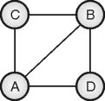

Hamiltonian Cycle – Example
Example: Show that given graph has a Hamiltonian cycle
Solution:
Step 1:
We can start with any random vertex. Let us start with vertex A. Neighbors of A are {B, C, D}. The inclusion of B does not lead to a complete solution.

Slide 33

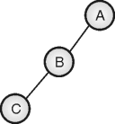
Hamiltonian Cycle – Example
Step 2:
Adjacent vertices to B are {C, D}. The inclusion of C does not lead to a complete solution. All adjacent vertices of C are already members of the path formed so far. So it leads to a dead end.
Step 3:
Backtrack and go to B and explore its next neighbor i.e. D.

Slide 34
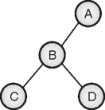
Hamiltonian Cycle – Example
Step 4:
The inclusion of D does not lead to a complete solution, and all adjacent vertices of D are already a member of the path formed so far. So it leads to a dead end.

Slide 35
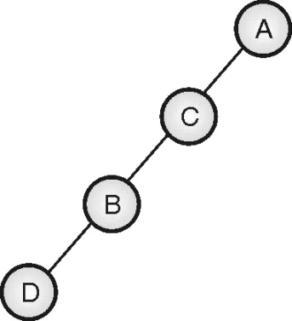
Hamiltonian Cycle – Example
Step 5:
Backtrack and go to B. Now B does not have any more neighbors, so backtrack and go to A. Explore the next neighbor of A i.e. C. By repeating the same procedure, we get the state space trees as shown below. And path A – C – B – D – A is detected as the Hamiltonian cycle of the input graph.

Slide 36
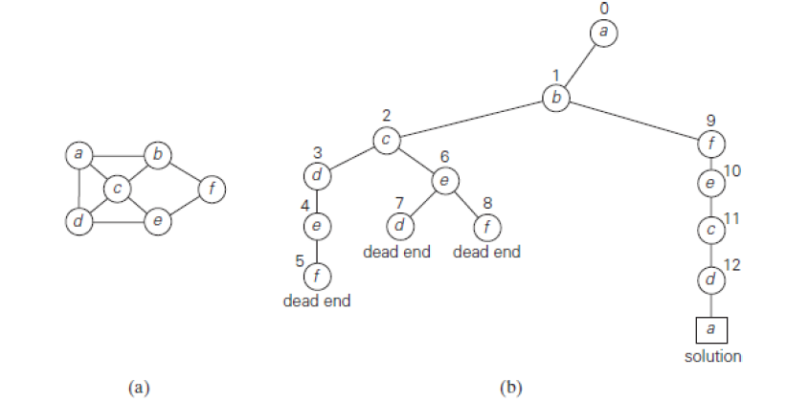
Hamiltonian Cycle – Example
Example 2
Graph
State Space Tree

Slide 37
Hamiltonian Cycle – Example
Explanation
Without loss of generality, we can assume that if a Hamiltonian circuit exists, it starts at vertex a.
Accordingly, we make vertex a the root of the state-space The first component of our future solution, if it exists, is a first intermediate vertex of a Hamiltonian circuit to be constructed.
Using the alphabet order to break the three-way tie among the vertices adjacent to a, we select vertex b.
From b, the algorithm proceeds to c, then to d, then to e, and finally to f, which proves to be a dead end.

Slide 38
Hamiltonian Cycle – Example
So the algorithm backtracks from f to e, then to d, and then to c, which provides the first alternative for the algorithm to pursue.
Going from c to e eventually proves useless, and the algorithm has to backtrack from e to c and then to b.
From there, it goes to the vertices f , e, c, and d, from which it can legitimately return to a, yielding the Hamiltonian circuit a, b, f , e, c, d, a.
If we wanted to find another Hamiltonian circuit, we could continue this process by backtracking from the leaf of the solution found.

Slide 39
Subset Sum Problem
Problem Statement
Given an array of non-negative integers and an integer sum. We have to find whether there exists any subset in an array whose sum is equal to the given integer sum.
Definition:
The subset-sum problem finds a subset of a given set A = {a1, . . . , an} of n positive integers whose sum is equal to a given positive integer d.
Example1:
The given array A = {1, 2, 5, 6, 8} and sum = 9. In this, there are two possible solutions: {1, 2, 6} and {1, 8}. Of course, some instances of this problem may have no solutions.

Slide 40
Subset Sum Problem
Example2:
Input: arr[] = {3, 34, 4, 12, 3, 2}, sum = 7 Output: True Explanation: There is a subset (4, 3) with sum 7
It is convenient to sort the set‘s elements in increasing order. So, we will assume that a1< a2 < . . . < an. Sum also denoted by d.
For Example,
A = {3, 5, 6, 7} and d = 15 of the subset-sum problem. The number inside a node is the sum of the elements already included in the subsets represented by the node. The inequality below a leaf indicates the reason for its termination.

Slide 41
Subset Sum Problem
Algorithm SumOfSub(s, k, r):
Input: s (current sum), k (current index), r (remaining sum)
Output: Find all subsets of w[1:n] that sum to m
if s == m:
Output the subset represented by x // Solution found
return
// Generate left child (include w[k])
if s + w[k] <= m:
x[k] = 1 // Include w[k] in the subset
SumOfSub(s + w[k], k + 1, r - w[k]) // Recurse with updated s and r
// Generate right child (exclude w[k])
if (s + r - w[k] >= m) and (s + w[k+1] <= m if k+1 < n):
x[k] = 0 // Exclude w[k] from the subset
SumOfSub(s, k + 1, r - w[k]) // Recurse without including w[k]

Slide 42
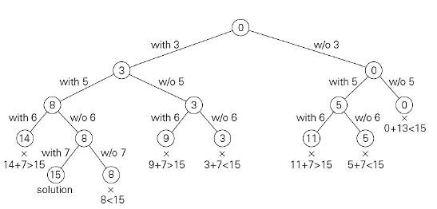
Subset Sum Problem
Problem:
Complete state-space tree of the backtracking algorithm applied to the instance. The state-space tree can be constructed as a binary tree like that in the instance A = {3, 5, 6, 7} and d = 15.

Slide 43
Subset Sum Problem
Explanation
The root of the tree represents the starting point, with no decisions about the given elements made as yet.
Its left and right children represent, respectively, inclusion and exclusion of a1 in a set being sought. Similarly, going to the left from a node of the first level corresponds to inclusion of a2 while going to the right corresponds to its exclusion, and so on.
Thus, a path from the root to a node on the i-th level of the tree indicates which of the first I numbers have been included in the subsets represented by that node. We record the value of s, the sum of these numbers, in the node.

Slide 44
Subset Sum Problem
If s is equal to d, we have a solution to the problem. We can either report this result and stop or, if all the solutions need to be found, continue by backtracking to the node‘s parent.
If s is not equal to d, we can terminate the node as non-promising if either of the following two inequalities holds
the sum s is too large
the sum s is too small

Slide 45
Subset Sum Problem
Complexity:
Time Complexity:
O(2^n) in the worst case, due to exploring all possible subsets.
Space Complexity:
O(n) for the recursion stack.
O(2^n) in the worst case if all subsets are stored.
O(n) is used for auxiliary space in calculations.

Slide 46
Graph colouring problem
Graph coloring problem involves assigning colors to certain elements of a graph subject to certain restrictions and constraints. This has found applications in numerous fields in computer science.
For example:
Sudoku: This game is a variation of Graph coloring problem where every cell denotes a node (or vertex) and there exists an edge between two nodes if the nodes are in same row or same column or same block.
Geographical maps: There can be cases when no two adjacent cities/states can be assigned same color in the maps of countries or states. In this case, only four colors would be sufficient to color any map.

Slide 47
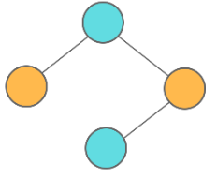
Graph colouring problem
Vertex coloring is the most commonly encountered graph coloring problem. The problem states that given m colors, determine a way of coloring the vertices of a graph such that no two adjacent vertices are assigned same color.
The smallest number of colors needed to color a graph G is called its chromatic number.
For example, the following undirected graph can be colored using minimum of 2 colors.
Hence the chromatic number of the graph is 2.

Slide 48
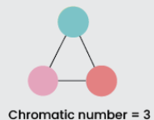
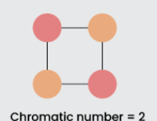
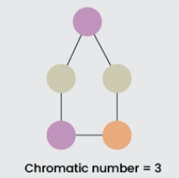
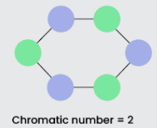
Graph colouring problem
Graph Coloring is a process of assigning colors to the vertices of a graph.
It ensures that no two adjacent vertices of the graph are colored with the same color.
Chromatic Number is the minimum number of colors required to properly color any graph.
Fig. Examples of Chromatic Number

Slide 49
Graph colouring problem
Algorithm of Graph Coloring using Backtracking:
Step 1: Assign colors one by one to different vertices, starting from vertex 0.
Step 2: Before assigning a color, check if the adjacent vertices have the same color or not.
Step 3: If there is any color assignment that does not violate the conditions, mark the color assignment as part of the solution.
Step 4: If no assignment of color is possible then backtrack and return false.

Slide 50
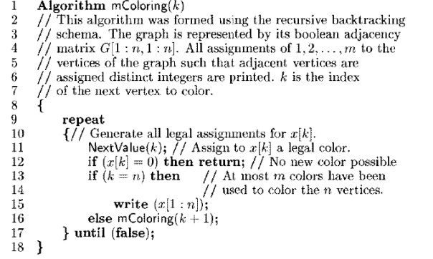
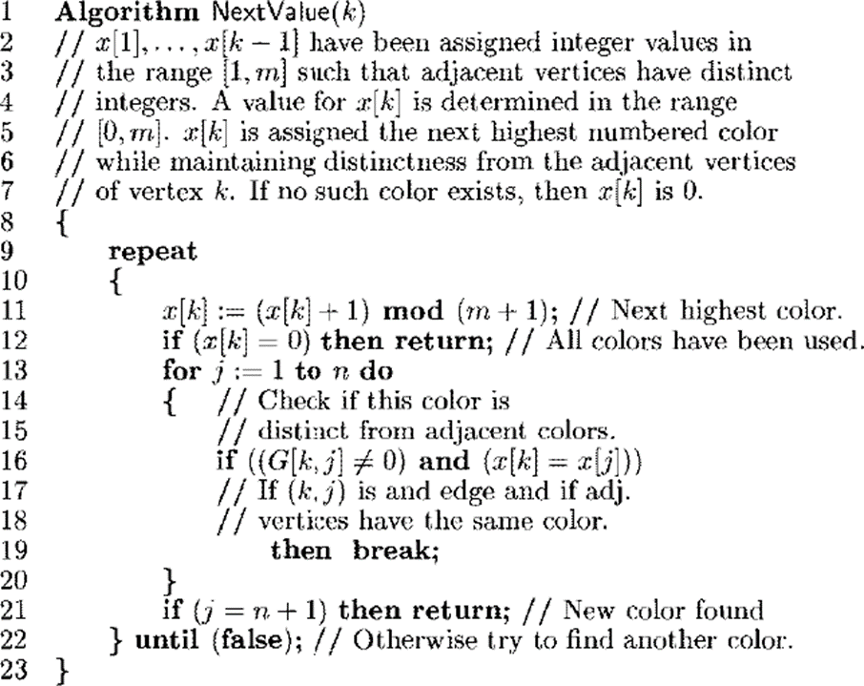
Graph colouring problem
Algorithm: Finding all m-colorings of graph
Algorithm: Algorithm: Finding next color

Slide 51
Graph colouring problem
Follow the given steps to solve the problem( Algorithm Explanation)
Create a recursive function that takes the graph, current index, number of vertices, and color array.
If the current index is equal to the number of vertices. Print the color configuration in the color array.
Assign a color to a vertex from the range (1 to m).
For every assigned color, check if the configuration is safe, (i.e. check if the adjacent vertices do not have the same color) and recursively call the function with the next index and number of vertices else return false
If any recursive function returns true then break the loop and return true
If no recursive function returns true then return false

Slide 52
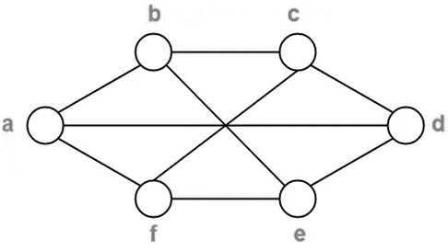
Graph colouring problem
Example 1: Find chromatic number of the following graph
Solution:
Step 1: Assign colors one by one to different vertices, starting from vertex 0.
Step 2: Before assigning a color, check if the adjacent vertices have the same color or not.
Note: It will continues if same color is not find
Vertex | a | b | c | d | e | f
Color | C1 | - | - | - | - | -
Vertex | a | b | c | d | e | f
Color | C1 | C2 | C1 | C2 | C1 | C2

Slide 53
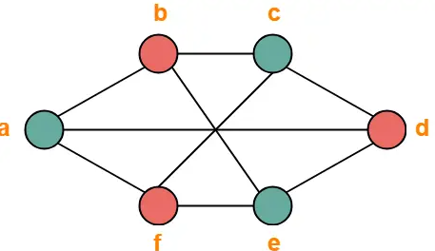
Graph colouring problem
Step 3: If there is any color assignment that does not violate the conditions, mark the color assignment as part of the solution.
Step 4: If no assignment of color is possible then backtrack and return false.
From here,
Minimum number of colors used to color the given graph are 2.
Therefore, Chromatic Number of the given graph = 2.
The given graph may be properly colored using 2 colors as shown below
Vertex | a | b | c | d | e | f
Color | C1 | C2 | C1 | C2 | C1 | C2

Slide 54
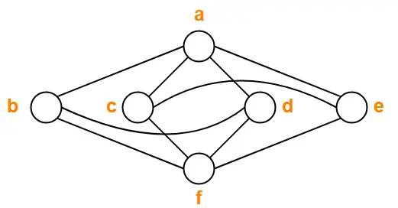
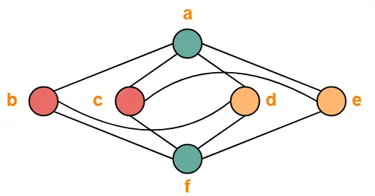
Graph colouring problem
Example 2
Vertex | a | b | c | d | e | f
Color | C1 | C2 | C2 | C3 | C3 | C1
Here
Minimum number of colors used to color the given graph are 3.
Therefore, Chromatic Number of the given graph = 3.
The given graph may be properly colored using 3 colors as shown below

Slide 55
Graph colouring problem
Example 2
Vertex | a | b | c | d | e | f
Color | C1 | C2 | C2 | C3 | C3 | C1
Here
Minimum number of colors used to color the given graph are 3.
Therefore, Chromatic Number of the given graph = 3.
The given graph may be properly colored using 3 colors as shown below

Slide 56
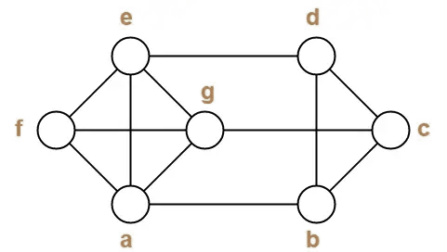
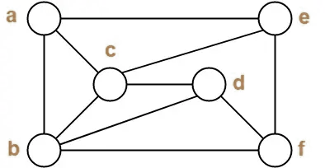
Graph colouring problem
Exercise

Slide 57
Travelling Salesman Problem
Given a set of cities and distance between every pair of cities, the problem is to find the shortest possible route that visits every city exactly once and returns back to the starting point.
The difference between Hamiltonian Cycle and TSP is Hamiltonian cycle problem is to find if there exist a tour that visits every city exactly once.
This problem can be solved using backtracking to explore all possible routes and find the optimal solution.

Slide 58
Travelling Salesman Problem
Approach to Solve TSP using Backtracking
In the backtracking approach, we explore each city and recursively check all paths to calculate the minimum cost path.
At each step, we try to go to an unvisited city, calculate the cost of that route, and backtrack if it’s not optimal, to try other possibilities.
Complexity
The backtracking solution to TSP has O(n!) time complexity because it explores all possible permutations of cities.
This approach is feasible only for small instances (typically n ≤ 10), as the time complexity grows factorially with the number of cities.

Slide 59
Travelling Salesman Problem
Steps of the Backtracking Approach
Start from a City: Choose an arbitrary starting city (typically city 0).
Explore All Possible Routes: From the current city, recursively visit all unvisited cities.
Calculate Cost: Keep a running total of the travel cost for the current path.
Prune: If the current path cost exceeds the minimum cost found so far, backtrack to prune the search.
Complete Cycle: Once all cities are visited, check if returning to the starting city produces a minimum-cost cycle.

Slide 60
Travelling Salesman Problem
Pseudocode for TSP
Define constant:
INF = a very large number
Function TSP(current_city, visited_set, current_cost):
Input:
current_city - the city currently being explored
visited_set - set of cities that have been visited
current_cost - accumulated cost of the current path
if all cities have been visited:
return current_cost + distance[current_city][start_city] // complete the cycle
min_cost = INF
for each city in range(N):
if city is not in visited_set:
Mark city as visited
total_cost = TSP(city, visited_set, current_cost + distance[current_city][city])
if total_cost < min_cost:
min_cost = total_cost
Unmark city as visited // backtrack
return min_cost // return minimum cost found from current_city

Slide 61
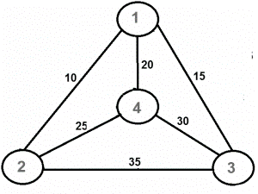
Travelling Salesman Problem
Example
Output of Given Graph: Minimum weight Hamiltonian Cycle : 10 + 25 + 30 + 15 = 80
Solution Approach
Step1: Starting Node Selection
Choose city 1 (node 1) as the starting point. Because TSP is cyclic, we can start from any city and end at the same city.
Aim to find a path that visits every other city once and returns to city 1, with the minimum possible travel cost. So we choose 1 → 2: Cost = 10

Slide 62
Travelling Salesman Problem
Step 2: Recursive Traversal
Use Depth-First Search (DFS) to explore all possible paths that start from city 1.
For each city, check the cost of traveling to each of its neighboring cities (cities that are directly connected).
Here from 1 to 2,3,4 will connected and choose min 2 → 4: Cost = 25
Step 3: Path Exploration
From city 1, explore different possible routes to visit each city exactly once before returning to city 1. The DFS explores all permutations of city visits and calculates the cost of each route.
Here based above rule chosen 4 → 3: Cost = 30

Slide 63
Travelling Salesman Problem
Step 4: Cost Calculation and Pruning
For each path explored, keep a running total of the travel cost.
3 → 1: Cost = 15
If the total cost of a path exceeds the minimum cost found so far, backtrack and try a different path.
This approach helps in pruning paths that would lead to higher costs, making the algorithm more efficient.

Slide 64
Travelling Salesman Problem
Finds the minimum travel cost. Here’s the breakdown:
1 → 2: Cost = 10
2 → 4: Cost = 25
4 → 3: Cost = 30
3 → 1: Cost = 15
Total Cost: 10+25+30+15=80, So the minimum Hamiltonian cycle with the least travel cost is 80.

Slide 65
Branch & Bound
The branch & bound approach is based on the principle that the total set of feasible solutions can be partitioned into smaller subsets of solutions.
These smaller subsets can then be evaluated systematically until the best solution is found.
Branch & bound is an algorithm design approach which is generally used for solving combinatorial optimization problems.
These problems are typically exponential in terms of time complexity and may require exploring all possible permutations in worst case.
The Branch & Bound Algorithm technique solves these problems relatively quickly.

Slide 66
Branch & Bound
The Lower and Upper Bound provides a way to find the lowest complexity algorithm to solve a problem.
Lower Bound:
Let L(n) be the running time of an algorithm A(say), then g(n) is the Lower Bound of A if there exist two constants C and N such that L(n) >= C*g(n) for n > N.
Lower bound of an algorithm is shown by the asymptotic notation called Big Omega (or just Omega).

Slide 67
Branch & Bound
Upper Bound:
Let U(n) be the running time of an algorithm A(say), then g(n) is the Upper Bound of A if there exist two constants C and N such that U(n) <= C*g(n) for n > N.
Upper bound of an algorithm is shown by the asymptotic notation called Big Oh(O) (or just Oh).

Slide 68
0/1 Knapsack Problem – Introduction
Let us consider the 0/1 Knapsack problem to understand Branch & Bound.
The Backtracking Solution can be optimized if we know a bound on best possible solution subtree rooted with every node.
If the best in subtree is worse than current best, we can simply ignore this node and its subtrees.
So, we compute bound (the best solution) for every node and compare the bound with current best solution before exploring the node.

Slide 69
0/1 Knapsack Problem – Introduction
We are given a certain number of objects and a knapsack.
Instead of supposing that we have n objects available, we shall suppose that we have n types of object, and that an adequate number of objects of each type are available.
Our aim is to fill the knapsack in a way that maximizes the value of the included objects.
We may take an object or leave behind, but we may not take fraction of an object.

Slide 70
0/1 Knapsack Problem – Algorithm
Algorithm BB_KNAPSACK(cp, cw, k)
// Description : Solve knapsack problem using branch and bound
// Input:
cp: Current profit, initially 0
cw: Current weight, initially 0
k: Index of item being processed, initially 1
// Output:
fp: Final profit
Fw: Final weight
X: Solution tuple
cp ← 0
cw ← 0
k ← 1
if (cw + w[k] ≤ M) then
Y[k] ← 1
if (k < n) then
BB_KNAPSACK(cp + p[k], cw + w[k], k + 1)
end
if (cp + p[k] > fp) && (k == n) then
fp ← cp + c[k]
fw ← cw + w[k]
X ← Y
end
end

Slide 71
0/1 Knapsack Problem – Algorithm
if BOUND(cp, cw, k) ≥ fp then
Y[k] ← 0
if (k < n) then
BB_KNAPSACK(cp, cw, k + 1)
end
if( cp>fp ) && ( k == n ) then
fp ← cp
fw ← cw
X ← Y
end
end
Upper bound is computed as follow :
Function BOUND(cp, cw, k)
b ← cp
c ← cw
for i ← k + 1 to n do
if (c + w[i] ≤ M) then
c ← c + w[i]
b ← b – p[i]
end
end
return b

Slide 72
0/1 Knapsack Problem
The bounding function is a heuristic computation. For the same problem, there may be different bounding functions. Apart from the above-discussed bounding function, another very popular bounding function for knapsack is,
ub = v + (W – w) * (vi+1 / wi+1)
where,
v is value/profit associated with selected items from the first i items.
W is the capacity of the knapsack.
w is the weight of selected items from first i items

Slide 73
0/1 Knapsack Problem
Given n items of known weights wi and values vi, i = 1, 2, ..., n, and a knapsack of capacity W, find the most valuable subset of the items that fit in the knapsack.
It is convenient to order the items of a given instance in descending order by their value-to-weight ratios.
Then the first item gives the best payoff per weight unit and the last one gives the worst payoff per weight unit, with ties resolved arbitrarily.
V₁/W₁≥V₂/W₂≥ ……. ≥V_{n}/W_{n}

Slide 74
0/1 Knapsack Problem
The state-space tree for this problem is constructed as a binary tree as mentioned below:
Each node on the ith level of this tree, 0≤i≤n, represents all the subsets of n items that include a particular selection made from the first i ordered items.
This particular selection is uniquely determined by the path from the root to the node:
A branch going to the left indicates the inclusion of the next item,While a branch going to the right indicates its exclusion.
Record the total weight w and the total value v of this selection in the node, along with some upper bound ub on the value of any subset that can be obtained by adding zero or more items to this selection.

Slide 75
0/1 Knapsack Problem
Lower bound calculation:
A simple way to compute the upper bound ub is to add to v, the total value of the items already selected, the product of the remaining capacity of the knapsack W - w and the best per unit payoff among the remaining items, which is vi+1/ w i+1:
ub = v + (W-w)( vi+1/ w i+1)

Slide 76
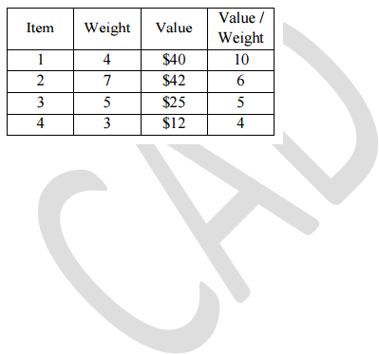
0/1 Knapsack Problem – Example
Example:
Solve the following instance of knapsack using Brand and Bound for knapsack capacity W = 10

Slide 77
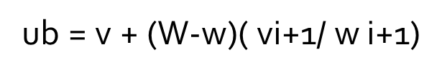
0/1 Knapsack Problem – Example
Solution:
State space tree construction:
Node 0:
At the root of the state-space tree, no items have been selected as yet. Hence, both the total weight of the items already selected w and their total value v are equal to 0. w=0, v=0
ub = 0 + (10-0) * ( 10) =100
The value of the upper bound computed by formula is 100.

Slide 78
0/1 Knapsack Problem – Example
Node 1:
The left child of the root represents the subsets that include item 1.
The total weight and value of the items already included are 4 and $40, respectively; the value of the upper bound is
ub = 40 + (10- 4)* 6 =76
Node 2 :
The node2 (right of node 1) represents the subsets that do not include item 1.
ub = 0 + (10-0)*6 =60
Since node 1 has a larger upper bound than the upper bound of node 2, it is more promising for this maximization problem, and branched from node 1 first.

Slide 79
0/1 Knapsack Problem – Example
Node 3 :
The node 3(left of node 1) with item 1 and with item 2
w=4+7=11, v=40;
vi+1/w i+1=5
Here w= 4+7=11>10. This is not a feasible solution since the constraints are not satisfied.
Node 4 :
The node 4 (right of node 1) with item 1 and without item 2 - w=4; v=40; vi+1/ w i+1=5
ub = 40+(10- 4)*5=70

Slide 80
0/1 Knapsack Problem – Example
Node 5:
Node 5 (left of node 4) with item 1 and item 3 – w=4+5=9; v=40 + 25 = 65; vi+1/ wi+1=4
ub = 65 + (10- 9)*4=69
Node 6:
Node 6 (right of node 4) with item 1 and without item 3 – w=4;v=40; vi+1/ w i+1=4
ub = 40 + (10-4)*4=64
The right node yields inferior upper bound. So the left node is selected for further expansion.

Slide 81
0/1 Knapsack Problem – Example
Node 7:
Node 7 (left of node 5) with item 1, 3 and with item 4 – w=3; v=12
Here w= 9+3=12>10.
This is not a feasible solution since the constraints are not satisfied.
Node 8:
Node 8(right of node 5) with item 1,3 and without item 4 w=9; v=65; vi+1/ w i+1=0
ub = 65 + (10- 9)*0=65

Slide 82
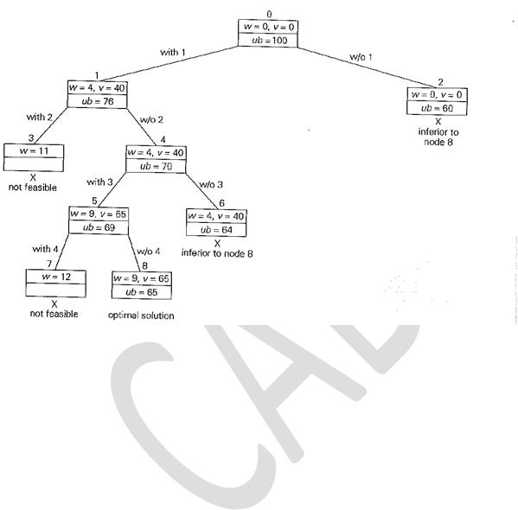
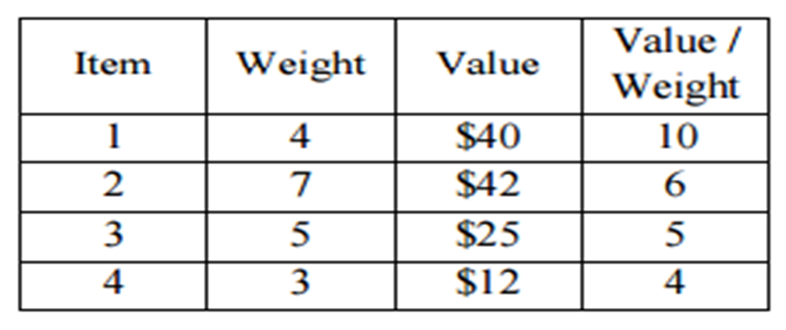
0/1 Knapsack Problem – Example
Hence the items in the knapsack are
{item 1, item 3} with the profit $65

Slide 83
Assignment problem
The branch-and-bound approach by applying it to the problem of assigning n people to n jobs so that the total cost of the assignment is as small as possible.
An instance of the assignment problem is specified by an n × n cost matrix C so that we can state the problem as follows:
select one element in each row of the matrix so that no two selected elements are in the same column and their sum is the smallest possible. We will demonstrate how this problem can be solved using the branch-and-bound technique by considering the small instance of the problem. Consider the data given below.

Slide 84
Assignment problem
The branch-and-bound approach by applying it to the problem of assigning n people to n jobs so that the total cost of the assignment is as small as possible.
An instance of the assignment problem is specified by an n × n, cost matrix C so that we can state the problem as follows:
select one element in each row of the matrix
so that no two selected elements are in the same column and their sum is the smallest possible.
We will demonstrate how this problem can be solved using the branch-and-bound technique by considering the small instance of the problem. Consider the data given below.

Slide 85
Assignment problem
The branch-and-bound approach by applying it to the problem of assigning n people to n jobs so that the total cost of the assignment is as small as possible.
An instance of the assignment problem is specified by an n × n, cost matrix C so that we can state the problem as follows:
select one element in each row of the matrix
so that no two selected elements are in the same column and their sum is the smallest possible.
We will demonstrate how this problem can be solved using the branch-and-bound technique by considering the small instance of the problem. Consider the data given below.

Slide 86
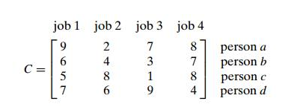
Assignment problem
Example:
Finding a Lower Bound for Optimal Selection
Purpose of Lower Bound:
A lower bound helps estimate the minimum possible cost of an optimal solution without fully solving the problem.
It provides a benchmark that the final solution, including the optimal solution, cannot go below.

Slide 87
Assignment problem
Method to Find the Lower Bound:
One simple approach is to sum the smallest elements in each row of the matrix.
This sum serves as a baseline for the minimum cost, though it doesn’t correspond to a valid solution (as multiple minimums may come from the same column).

Slide 88
Assignment problem
3. Example Calculation:
For a given cost matrix, the sum of the smallest values in each row:
Row 1: Smallest element = 2
Row 2: Smallest element = 3
Row 3: Smallest element = 1
Row 4: Smallest element = 4
Lower Bound = 2 + 3 + 1 + 4 = 10
Note: This value (10) is not the cost of any actual selection but serves as a lower bound for any valid solution.

Slide 89
Assignment problem
4. Applying Lower Bound to Partial Solutions:
For partially constructed solutions, adjust the lower bound by including the specific selections already made.
Example: If 9 is chosen from the first row, adjust the lower bound to:
Lower Bound = 9 + 3 + 1 + 4 = 17
This adjusted lower bound guides the search for valid solutions from this partial configuration.

Slide 90
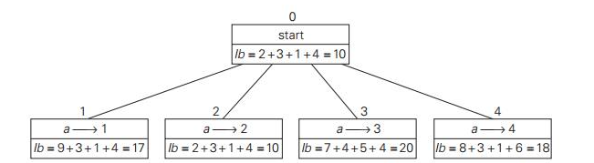
Assignment problem
Fig.1 Levels 0 and 1 of state space for the instance of assignment problem

Slide 91
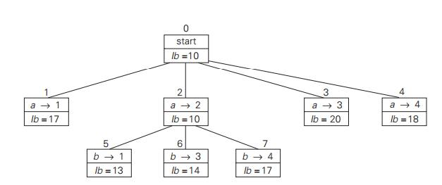
Assignment problem
Fig.2 Levels 0,1 and 2 of state space for the instance of assignment problem

Slide 92
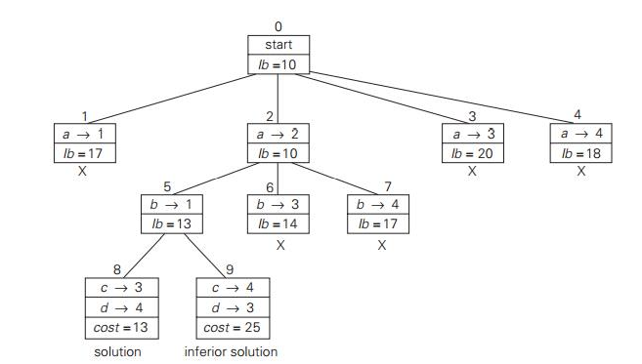
Assignment problem
Fig.2 Complete state space for the instance of assignment problem

Slide 93
Thank you!!

